Slide 1
Machine Learning in Practice I
Lecture 10
Antal Jakovac, 2025

Slide 2
Linear regression inter- and extrapolation

Slide 3


Linear regression
interpolation vs. extrapolation
after function fitting we can predict values
data lay in
  interpolation: prediction for
  extrapolation: prediction for
dangers of interpolation → overfitting
dangers of extrapolation → …

Slide 4
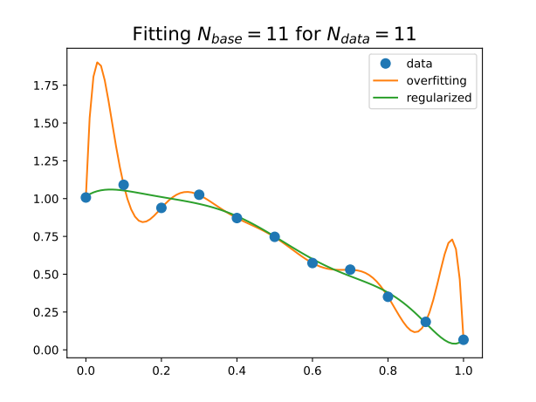
Linear regression
dangers of interpolation → overfitting
example: fit polynomial basis to data points
original model with
fitted model:
with and or without regularization
result:
  exact fit, hits all points → bad interpolation
  worse at the edges
  regularization helps

Slide 5
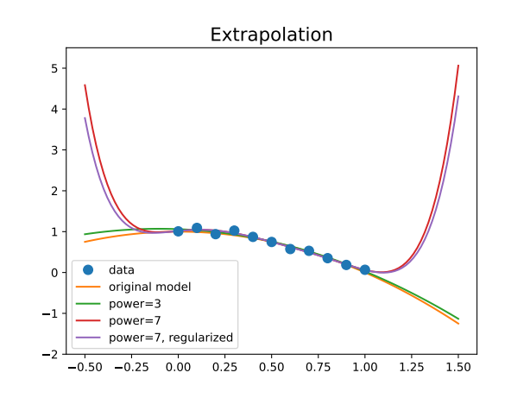
Linear regression
dangers of extrapolation → avoid extrapolation
fitting lower and higher order polynomials
results:
  inside the data range all fits are correct
  outside all fail
  the more robust (fewer parameters)
  the better
  regularization does not help!

Slide 6
Linear regression
dangers of extrapolation → avoid extrapolation
fitting lower and higher order polynomials
results:
  inside the data range all fits are correct
  outside all fail
  the more robust (fewer parameters)
  the better
  regularization does not help!
☠️ proceed and perish!⚠️

Slide 7
Linear regression
controlling extrapolation
  use bounded basis → avoid polynomials!
  require asymptotic behaviour (i.e. function form at infinity)
  → transforms extrapolation to interpolation
  use the model requiring the fewest parameters (robust modelling)
  extend data in a sensible way

Slide 8
Nonlinear regression

Slide 9
Nonlinear regression
we can have a general data model
minimize
no direct methods → recursive approach
  steepest descent method
  random algorithms → Metropolis method with simulated annealing
  challenges at higher dimensions

Slide 10
Steepest descent method
iteration
  choose a starting point
  establish an iteration
  try to ensure that
in steepest descent method: linear approximation around
length of a vector → choose
in linear approximation

Slide 11
Steepest descent method
advantages:
  simple, low cost
  requires only first derivative → numerically or automatic differentiation
  flexible: stochastic and mini batch versions in high dimensions
disadvantages:
  slow (linear convergence), especially near minimum
  for ill-conditioned functions long iteration path → conjugate gradient
  sensitive to local minima → use momentum (Nesterov acceleration)
  can lead to runaway solutions → adaptive step size, gradient clipping

Slide 12
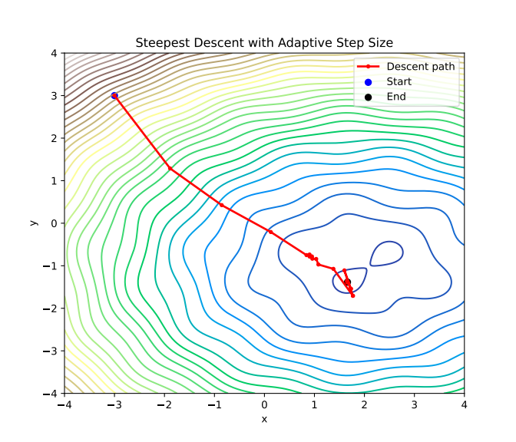
Adaptive step length
in the iteration change the step length r
  if → choose
  else choose
  if or stop iteration
2D example with

Slide 13
Simulated annealing
choose a random direction and a positive number
if → choose
else still accept with a probability
T is the “temperature” controlling exploration
the values in have a distribution
  can be used in Monte Carlo simulation (Metropolis algorithm)
if we need the minimum, decrease T → simulated annealing (SA)

Slide 14
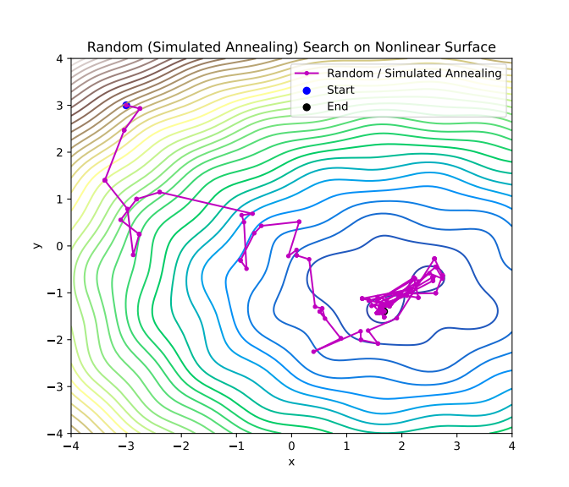
Simulated annealing
the same example as before
advantages:
  no gradient is needed
  can escape local minima
  parallelizable
drawbacks:
  slow convergence
  difficult to use in batch methods → rarely used in DNNs

Slide 15
Feature optimization
Perceptron

Slide 16
Linear Features
we can tailor features instead of the original ones
simplest: linear combination → looks for a hyperplane to separate classes
can be generalized → curved separator surface
implementation:
  perceptron (linear)
  Support Vector Machine (linear + nonlinear)
  Extreme Learning Machine (ELM) (nonlinear)

Slide 17
Perceptron
one of the first AI algorithm (Rosenblatt, 1958)
→ newspapers: “the electronic brain that can walk, talk, see, write, reproduce itself, and be conscious of its existence”
idea:
  two classes with labels , data are d dimensional
  look for a vector w and a constant b that satisfies
  possible loss function to be maximized
  Rosenblatt’s algorithm: if we find a misclassified point

Slide 18
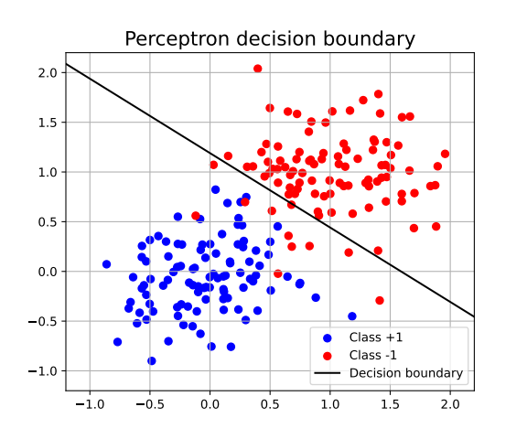
Perceptron
example: 2D points
accuracy: 95.5%

Slide 19
Perceptron
classification by analytic expression → several classes
class labels → analytic expressions
one-hot encoding:
  , the ith unit vector
  n classes → n dimensional output
other (vector) encodings:
  D dimensional output
  mapping is optimized by some condition (e.g. semantics for words)

Slide 20
Support Vector Machine

Slide 21
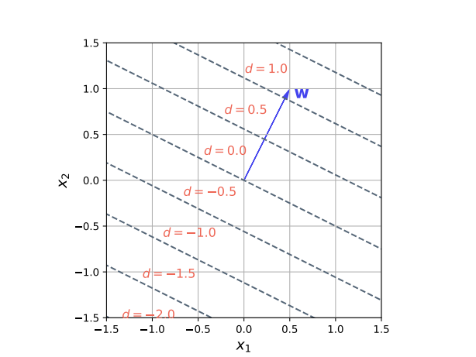
Support Vector Machine
improved perceptron to maximize margin
logic:
  define a w vector → the selective coordinate is
  try to separate the two sets using this feature
  for optimal w use 1D methods (e.g. hinge loss)
  in the training use the nearest point to write
  up w → support vectors
  Python package: svm

Slide 22
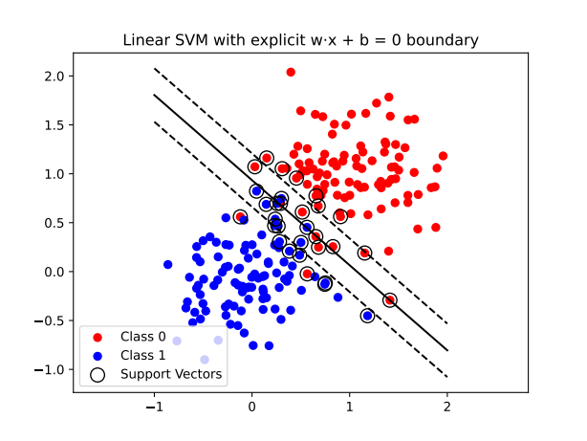
Support Vector Machine
# Support Vector Machine example
from sklearn import svm
from sklearn.metrics import accuracy_score
clf = svm.SVC(kernel='linear', C=1.0)
clf.fit(X, y)
# 🔮 Predict on the test set
y_pred = clf.predict(X_test)
# 🧮 Evaluate
acc = accuracy_score(y_test, y_pred)
→ acc = 96.5%

Slide 23
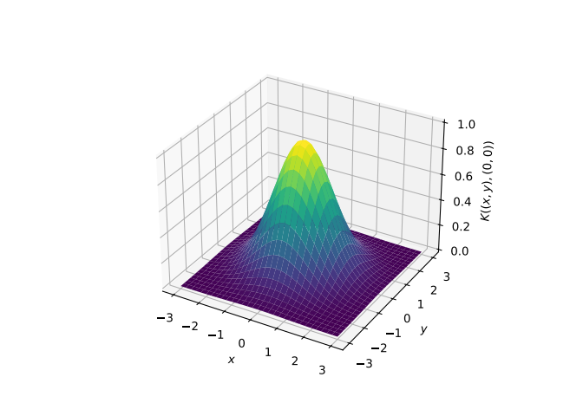
Support Vector Machine
we can use also nonlinear combinations (kernel)
most used: Gaussian kernel
  around each point we take a “bump”
  complete kernel is a linear combination
  (using ±1 as labels)
  resulting surface is a landscape with
  hills and valleys
  in practice it is enough to consider only a small number of points (support vectors) to represent the surface

Slide 24
Support Vector Machine
we can use arbitrary kernel
fitting and learning:
  linear combination parameters are learned using data
  kernel parameters are fixed in the learning process, and tuned for best performance (using grid search, cross validation)
  Deep Neural Networks work in a similar manner, there the functional space is a nested (layered) function composition.
  decision based on a single (although) complicated feature

Slide 25
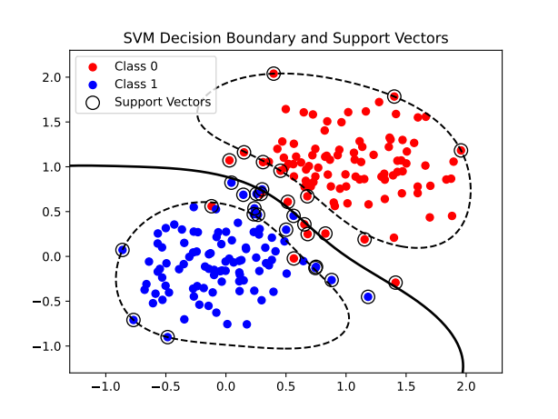
Support Vector Machine
in the code we should use the ‘rbf’ kernel (Radial Basis Function)
# Support Vector Machine example
from sklearn import svm
from sklearn.metrics import accuracy_score
clf = svm.SVC(kernel='linear', C=1.0)
clf.fit(X, y)
# 🔮 Predict on the test set
y_pred = clf.predict(X_test)
# 🧮 Evaluate
acc = accuracy_score(y_test, y_pred)
→ acc = 97.5%

Slide 26
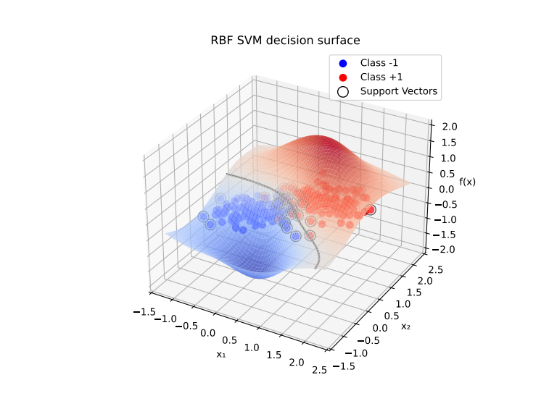
Support Vector Machine
in the code we should use the ‘rbf’ kernel (Radial Basis Function)

Slide 27
END OF LECTURE 10

